Slide 1

Coffee Quality Analysis Using Power BI
Capstone Project

Slide 2
Project Overview
This project analyzes coffee quality data from the Coffee Quality Institute (CQI).
The objective is to understand factors affecting coffee quality.
Power BI is used for data cleaning, analysis and visualization

Slide 3
Data Set Description
The data set contains sensory evaluation scores of coffee.
Attributes include aroma, flavor, acidity, body and total cup points.
It also includes processing methods, regions and defects information.

Slide 4

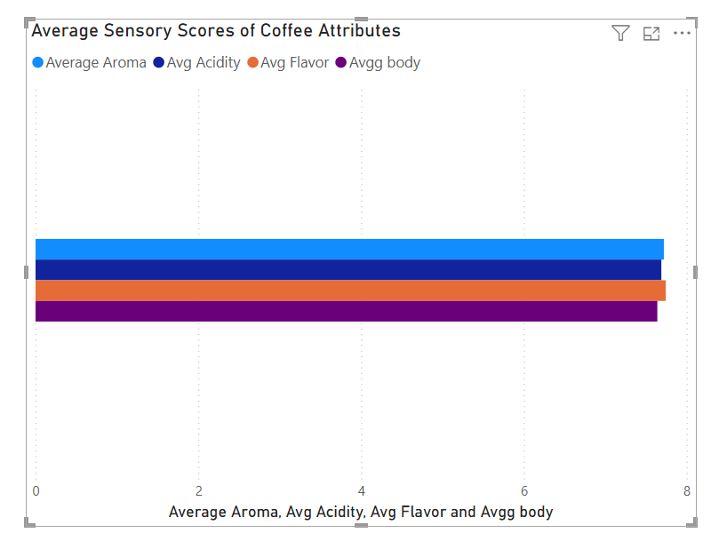
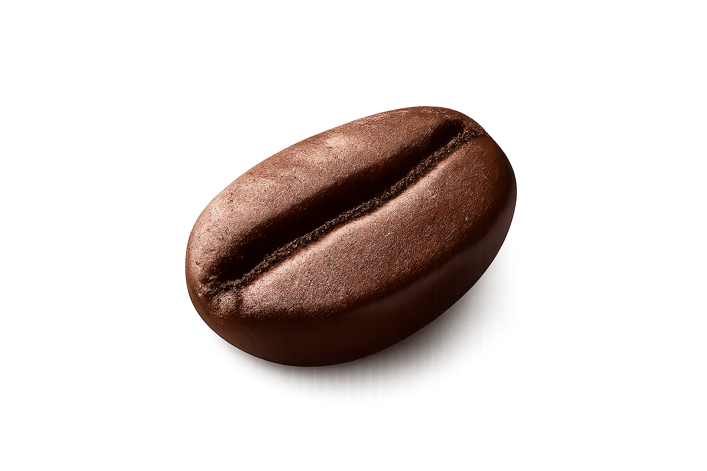
Key Determinants Of Coffee Quality
Flavor and aroma have the highest average scores.
Body and acidity contribute moderately to coffee quality.

Slide 5
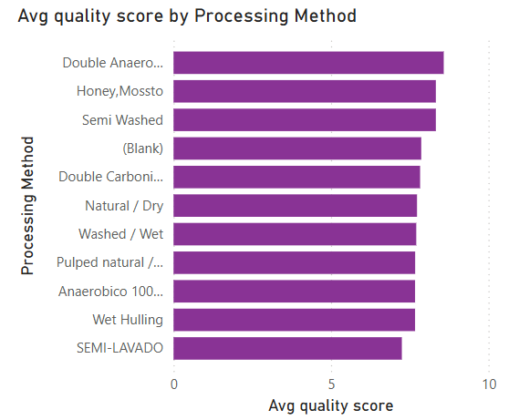
Effect of Processing Method on Coffee Quality Scores
Coffee quality scores vary across different processing methods.
Certain processing methods are associated with higher average quality scores.

Slide 6
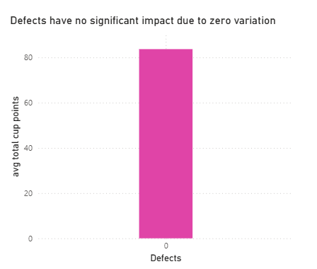
Impact Of Defects On Coffee Quality
Most coffee samples show zero or very low defect values.
Due to minimal variation in defects, there is no significant impact on overall coffee quality.

Slide 7
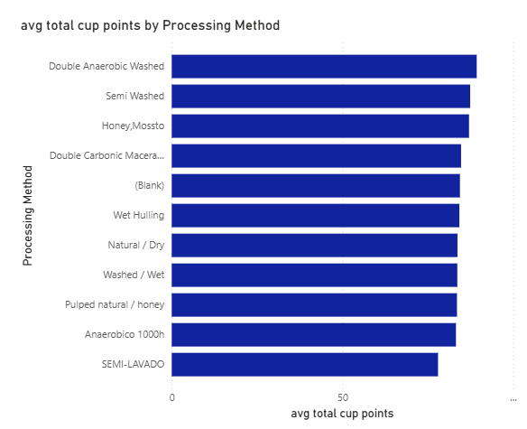
Effects Of Processing Method On Total Cup Points
Total cup points vary across different processing methods.
This indicates that processing method influences overall coffee quality.

Slide 8
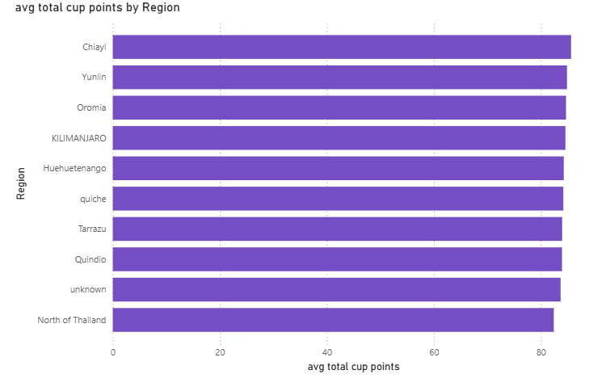
Regional Influence On Total Cup Points
Total cup points differ across regions.
This shows that region and environmental conditions affect coffee quality.

